Slide 1

Warby Parker Funnel Analysis
Learn SQL from Scratch
Samie Belal
7/17/18

Slide 2
Table of Contents
Background of Warby Parker
Quiz Style Funnel
What is the Home Try-On Funnel
SQL Data Used

Slide 3
Warby Parker Background

Slide 4
Warby Parker Background
Founded in 2010 and was named after 2 characters in a Jack Kerouac Journal
Warby Parker’s goal is to deliver creative thinking, smart design, and doing good for the world
For every pair of optical sold, a pair is given to someone in need

Slide 5
Quiz Style Funnel

Slide 6
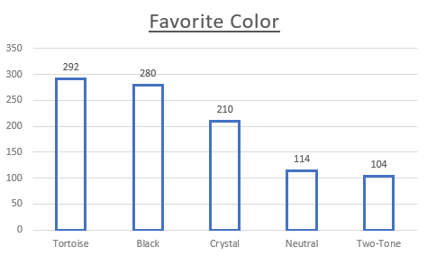
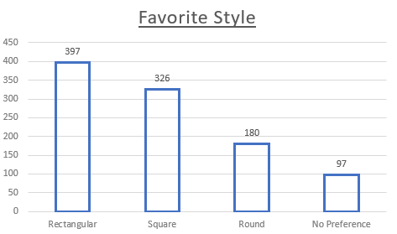
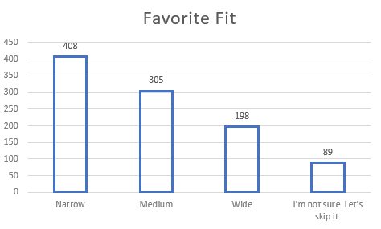
Quiz Funnel Results

Slide 7
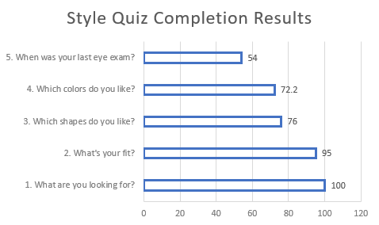
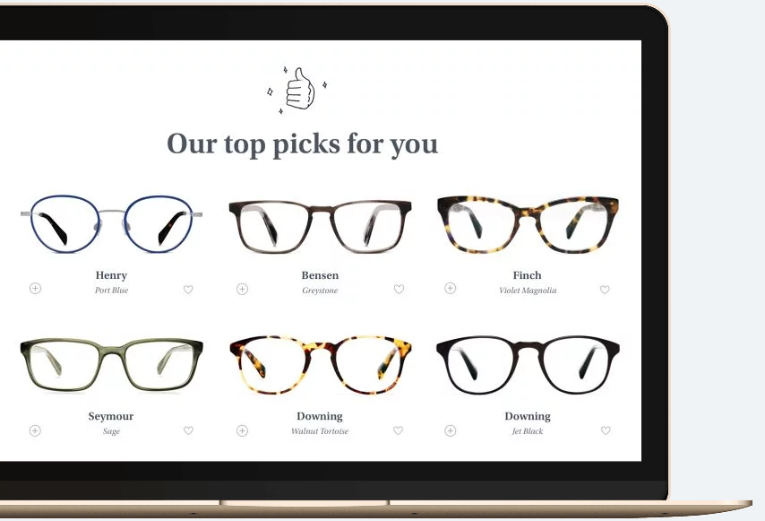
Results From Style Quiz
Only 54% of all potential consumers actually completed the quiz.
Question 5 may be too complicated for consumers to answer on spot or are not comfortable with sharing.
Questions 3 & 4 have similar completion rates suggesting they are good questions to follow each other with.

Slide 8
What is the Home Try-On Funnel

Slide 9
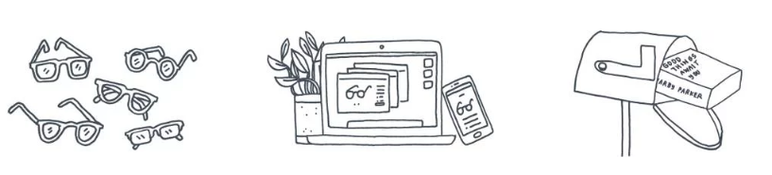
Quiz Funnel
An A/B test was given in order to determine whether consumers were more prone to purchasing a pair of glasses given they were allowed to try 3 or 5 pairs of glasses
Consumers first take the style quiz, are then allowed to move on to the Home Try-On phase, and then
Move onto purchasing the product. The Funnel allows us to determine whether they complete the
Purchase or not and at which phase consumers felt they should not buy the product anymore.

Slide 10
Conversion Rates
49.5%
Total
Conversion
Style Quiz
Home Try-On
Purchase
75%
Quiz to Home Conversion
66%
Home to Purchase Conversion

Slide 11
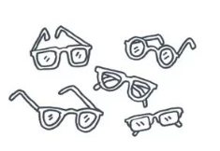
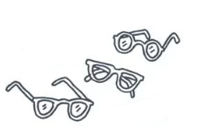
Consumers who took 5 pairs of glasses had a higher chance of purchasing a pair of glasses than those who opted to take only 3 pairs of glasses (A/B Test)
Almost 79% of consumers ended up purchasing a pair of glasses when they took 5 pairs
Only 53% of consumers bought a pair of glasses when they took 3 pairs of glasses

Slide 12
Recommendations
Switch the order of the questions to encourage a completion of the Quiz
Question 5 should be first and reworded to “Have you taken an eye exam in the past year?”
The rest of the questions can follow as normal
In order to make more consumers buy glasses, allow them to try 5 pairs of glasses
Based on the results of the survey, provide specific pairs of glasses they can buy. However, even after final recommendations are provided, allow customization of the final product to allow more personalization

Slide 13
SQL Data Used

Slide 14
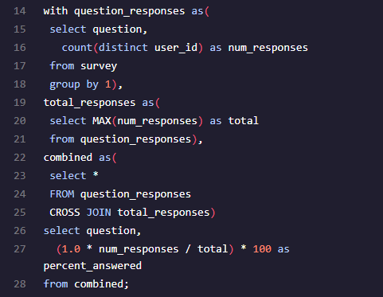
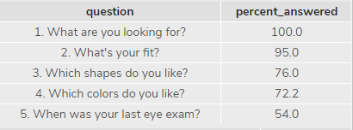
Code

Slide 15
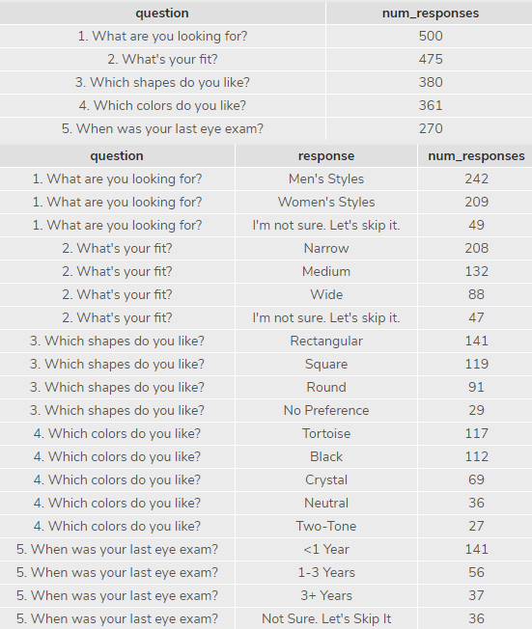
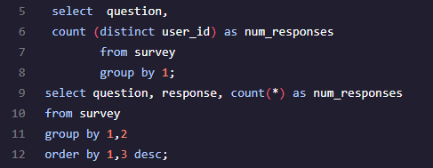
Code cont.

Slide 16
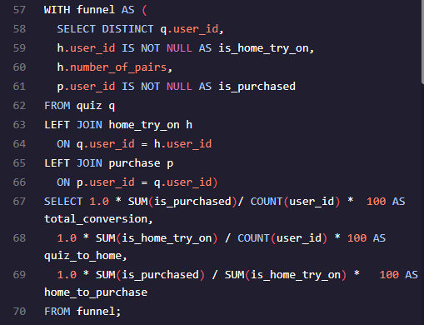
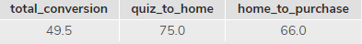
Code cont.

Slide 17
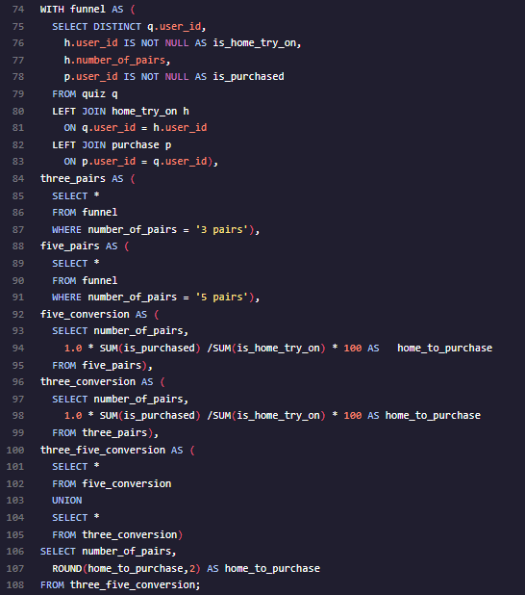
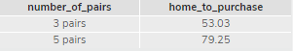
Code cont.

Slide 18
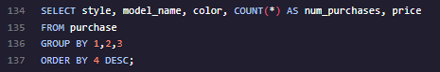
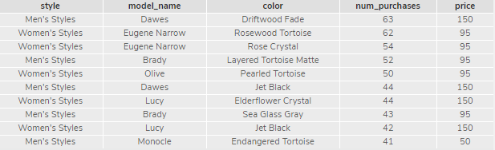
Code cont.

